Slide 1
BBS1 and Bardet-Biedl Syndrome
By: Kalyn Yasutake

Slide 2
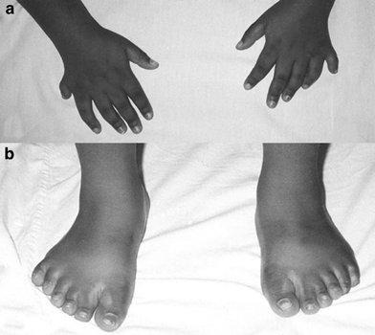
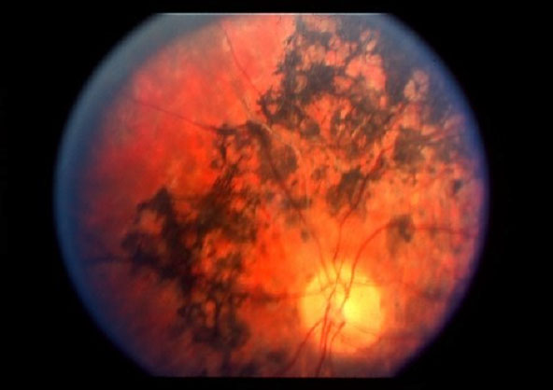
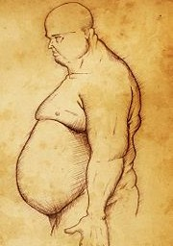
What is Bardet-Biedl Syndrome?
Rod-Cone Dystrophy
Polydactyly
http://trialx.com/curetalk/wp-content/blogs.dir/7/files/2011/05/diseases/Cone_Rod_Dystrophy-2.jpg
Obesity
http://www.nature.com/eye/journal/v20/n1/images/6701786f1.jpg
http://t2.gstatic.com/images?q=tbn:ANd9GcTnKbFOvAGzoMBhDrRYlswej9mlOOeclsN9eFhTWKueI7wVagTXkw
Notes:
Multiorgan disease characterized by wide range of symptoms
These three are the most common

Slide 3
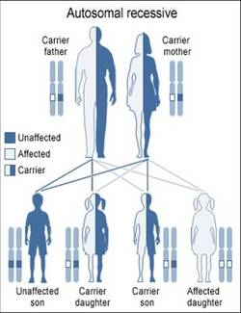
What Causes Bardet-Biedl Syndrome?
14 BBS genes known
Autosomal recessive inheritance
http://www.web-books.com/eLibrary/Medicine/Appendix/AutoRecessive.jpg
Notes:
There are 14 BBS genes known
Different mutations identified in these genes can cause this disease
It’s inherited in an autosomal recessive manner
This disease is classified as a ciliopathy which is a disease that affects the cilia
-specifically in this disease it disrupts the primary cilia of cells

Slide 4
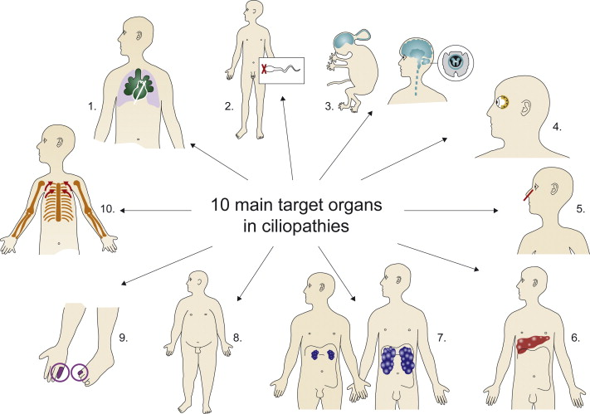
What is Affected By Ciliopathies?
http://www.sciencedirect.com/science/article/pii/S1350946211000164

Slide 5
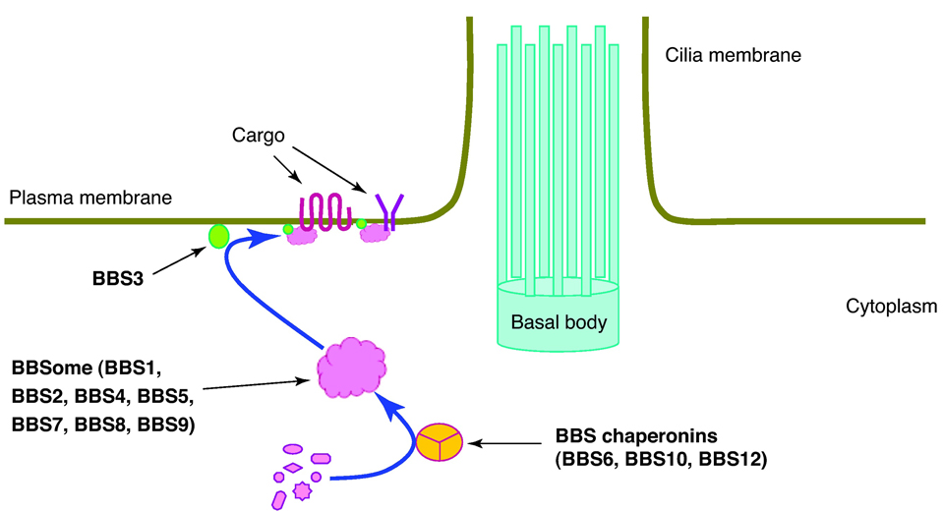
BBS1 is apart of a Complex the BBSome
http://www.ncbi.nlm.nih.gov/pmc/articles/PMC3130119/bin/nihms290894f1.jpg
Notes:
BBS1 is apart of an important complex called the BBSome
-made up of 7 different BBS proteins (1,2,4,5,7,8, and 9)
These proteins come together and form the BBSome
The BBSome is important in ciliogenesis which is the formation of the primary cilia
Specifically it is important in ciliary membrane biogenesis- it traffics certain membrane proteins
It also interacts with the intraflagellar transport pathway to regulate signal transduction of the primary cilia-one such example that has been shown is the sonic hedgehog signaling
Localizes at the basal body of cilia

Slide 6
BBS1 is Mutated in Bardet-Biedl Syndrome
WD40 Domain
314-377
390
Mutation: M390R
Notes:
A Mutation in the BBS1 gene is the most common cause of Bardet-Biedl Syndrome
Most common mutation that results in Bardet-Biedl syndrome is a mutation found in at position 390 where a methonine is instead an arginine
-M390R

Slide 7
BBS1 is Highly Conserved
WD40 Domain
Organism
Size of Gene
Human
BBS1
314-377
593
Mouse
Bbs1
314-377
593
Rat
Bbs1
315-378
594
Zebra fish
bbs1
309-372
588
Fruit Fly
BBS1
309-372
605
Worm
bbs-1
299-361
576
Notes:
BBS1 is highly conserved across many organisms
It has the WD40 Domain across all BBS1 genes

Slide 8
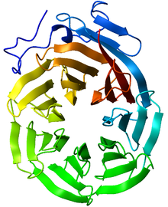
The WD40 Domain Makes a β-Propeller
http://pfam.sanger.ac.uk/family/PF00400
Notes:
WD40 repeat is a short structural motif
These repeats fold together in a circular solenoid protein domain called the WD40 Domain
This domian usually has 4-16 repeating units which form a circularised beta propellor strucutre
Common function of all WD40-repeat proteins is coordinating multi-protein complex assemblies-repeating units serve as a rigid scaffold for protein interactions
-See in the BBSome
WD40 is also found in BBS2,7, and 9

Slide 9
Obesity is a Major Symptom in Bardet-Biedl Syndrome
Leptin receptors are mistrafficked to primary cilia
http://t2.gstatic.com/images?q=tbn:ANd9GcTnKbFOvAGzoMBhDrRYlswej9mlOOeclsN9eFhTWKueI7wVagTXkw
Notes:
Leptin is a hormone that regulates energy intake and expenditure
-including apptite and hunger
It has been theorized that the leptin receptor is mistrafficked to the primary cilia of cells
In addition, it has been shown that BBS1 interacts directly with the leptin receptor
However, it is known that fat control is under polygenic control

Slide 10
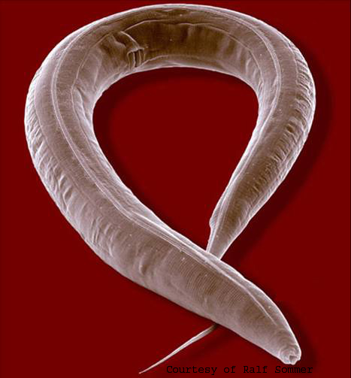
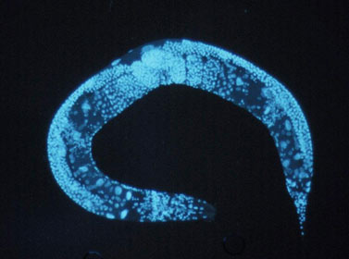
How do C. Elegans Accumulate Fat?
http://natureafield.com/wp-content/uploads/2012/05/C-elegans.jpg
http://www.lipidmaps.org/update/2009/091201/images/lipidmaps.2009.33-i1.jpg
Notes:
C. Elegans lack leptin!
But do present with a greater fat accumulation when BBSome is disrupted
Also shows intestinal defects which is further interesting because that’s where they take in their fat
C. Elegans have similar adipose regulatory system as seen earlier in the school year in some of the articles we read
-conserved between humans and C. elegans
-already identified similar fat regulatory systems seen in earlier sections
However their body fat regulation is hinged to food sensation and perhaps neuroendocrine signaling
My idea is that there is some defect in sensing of a different hormone, neuropeptide, etc that causes a greater fat accumulation in these worms

Slide 11
What Proteins that Interact with BBS1 Are Involved in Fat Regulation?

Slide 12
che-11 and che-13 Function in C. Elegans
Functions in intraflagellar transport system
Che-11 orthologous to KIAA0590
Che-13 homologous to IFT57/H
http://www.wormbook.org/chapters/www_ciliumbiogenesis/ciliafig2.jpg
Notes:
Known to function in Intraflagellar Transport system which is the trafficking of molecules through the cilium
Believed it is needed for correct ciliogensis of sensory cilia-could therefore be a defect in sensing of the internal homeostasis
Che-11 has an ortholog in humans→ KIAA0590
Che-13 has a homolog in humans→ IFT57/Hippi

Slide 13
Hypothesis
che-11 and che-13 have an necessary role in fat accumulation

Slide 14
Are che-11 and ch-13 Necessary in Fat Regulation?
Wild Type
che-11 and che-13
Notes:
RNAi of che-11 and che-13 and seeing the accumulation of fat droplets in C. elegans through niles red intake as in the one paper
Believed to show a greater accumulation of fat droplets
(show pictures from one paper)

Slide 15
che-11 and che-13 Function in Dauer Formation
No Insulin
http://www.wormatlas.org/ver1/handbook/fig.s/IntroFIG8B_I.jpg
Notes:
In worm base, it was seen that che-11 and che-13 mutants were shown to have defective dauer formation
Dauer formation can be caused by lack of nutrients and therefore does not produce insulin
If you remember from biology insulin causes cells in the body to uptake glucose from the blood
-its produced in response to your blood glucose level
When there is a lack of insulin it causes a cascade of events that causes Dauer formation

Slide 16
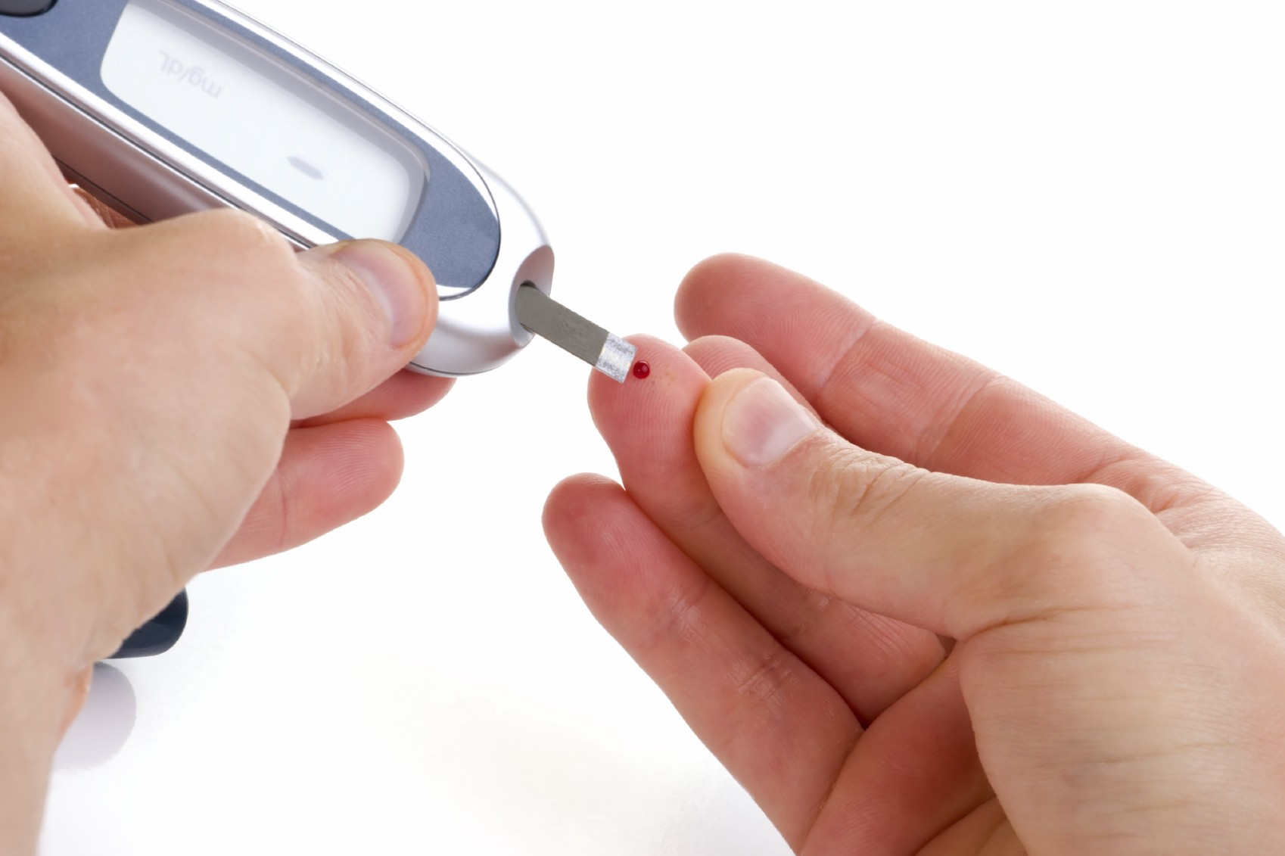
BBS patients are at a higher risk for Type II Diabetes
http://theaustintimes.com/wp-content/uploads/2013/04/diabetes.jpg
Notes:
This is where the body becomes insulin resistant-it does not or insulin deficient where the body stops making it→ usually due to the fact that it is constantly making high levels of insulin
This coupled with defective dauer formation and the fact that che-11 and che-13 cause greater accumulation of fat indicates that there could be a greater release of insulin in c. elegans with bbs and due to the fact that sensory neurons are defective and do not sense the homeostasis of fat accmulation in the body and cause a greater amount to be released than normal

Slide 17
Hypothesis
There will be a greater production of insulin in affected C. elegans
Notes:
This could point to a lack sensing insulin and therefore produce more

Slide 18
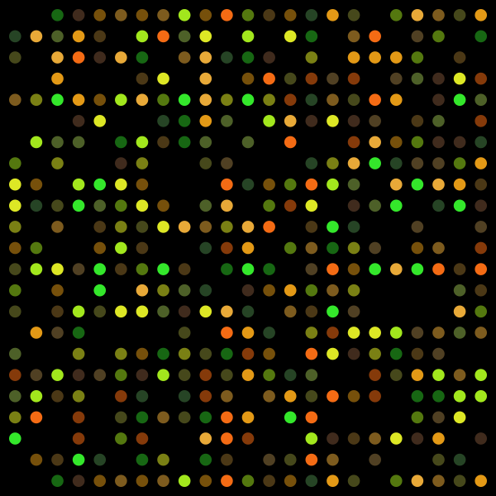
What are the Expression Levels of Insulin-like genes in mutants?
bbs-1, che-11, and che-13 compared to normal
http://upload.wikimedia.org/wikipedia/commons/thumb/2/2a/DNA_microarray.svg/600px-DNA_microarray.svg.png
Notes:
38 insulin like genes
Che-11, che-13, bbs-1, and wt
Neurons are where insulin-like proteins are secreted therefore screening to see if there is an overexpression of these genes in these tissues

Slide 19
Why is this Important?
Points to a new understanding of how obesity is caused in Bardet-Biedl patients
Could lead to greater understanding and a way in which to treat this one symptom
http://t2.gstatic.com/images?q=tbn:ANd9GcTnKbFOvAGzoMBhDrRYlswej9mlOOeclsN9eFhTWKueI7wVagTXkw
Notes:
Points to a new understanding of how obesity is caused in Bardet-Biedl patients
Many different problems are cause from Obesity (Type II diabetes, cardiac problems, etc)
Could lead to greater understanding

Slide 20
Future Directions
Characterizing che-11 and che-13 in greater depth
Looking at the their homologs in human cell lines
Looking into proteins that could contribute to dysfunction in the kidneys seen in BBS patients

Slide 21
References
Ashrafi, K. et al. (2003). Genome-wide RNAi analysis of Caenorhabditis elegans fat regulatory genes. Nature, 421. Retrieved from: http://www.nature.com/nature/journal/v421/n6920/abs/nature01279.html
Badano, J.L. et al. (2003). Identification of a Novel Bardet-Biedl Syndrome Protein, BBS7, That Shares Structural Features with BBS1 and BBS2. American Journal of Human Genetics, 72, 650-8. Retrieved from: http://www.ncbi.nlm.nih.gov/pubmed/12567324
Deng-Fu Guo and Kamal Rahmouni. (2011). Molecular basis of the obesity associated with Bardet-Biedl Syndrome. Trends Endorinol Metab., 22(7), 286-293. doi: 10.1016/j.tem.2011.02.009.
Lee, B.H. et al. (2011). Hyperactive Neuroendocrine Secretion Cuases Size, Feeding, and Metabolic Defects of C. elegans Bardet-Biedl Syndrome Mutants. PLOS biology, 9(12). doi:10.137/journal.pbio.1001219.
Mak, H. Y. et al. (2006). Polygenic control of Caenorhabditis elegans fat storage. Nature Genetics 38. doi: 10.1038/ng1739.
Mukhopadhyay, S. et al. (2013). Cilia, tubby mice, and obesity. Cilia, 2(1). doi: 10.1186/2046-2530-2-1.
Mykytyn, K. et al. (2003). Evaluation of Complex Inheritance Involving the Most Common Bardet-Biedl Syndrom Locus (BBS1). American Journal of Human Genetics, 72(2), 429-37. Retrieved from: http://www.ncbi.nlm.nih.gov/pmc/articles/PMC379234/
Seo, S. et al. (2009). Requirement of Bardet-Biedl syndrome proteins for leptin receptor signaling. Human Moelcular Genetics, 18(7). doi: 10.1093/hmg/ddp031.

